Slide 1
Astrocyte development and diversity NS201B December 4, 2015
Anna Victoria Molofsky MD PhD
Assistant Professor
Department of Psychiatry
University of California San Francisco
Notes:
I want to thank the committee for the opportunity to be here and talk about my work. I’m a postdoctoral fellow wiith Dr. David Rowitch at UCSF, and I’m also a psychiatrist. I’m going to tell you today that there is an intimate relationship between local astrocytes and the neurons they support- in this case, a spinal cord motor neuron. Understanding this interaction is criticall to really understanding circuit development and dysfunction.

Slide 2
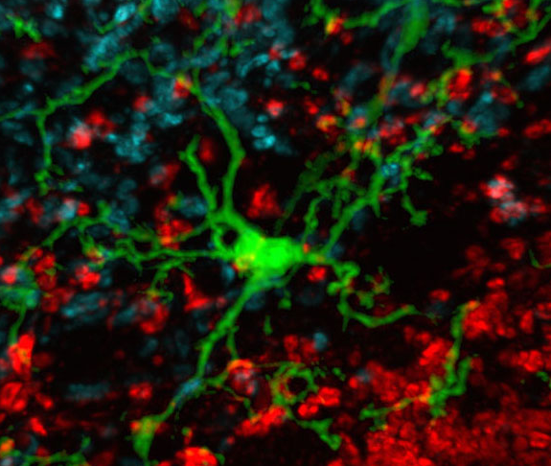
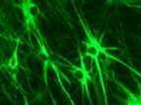
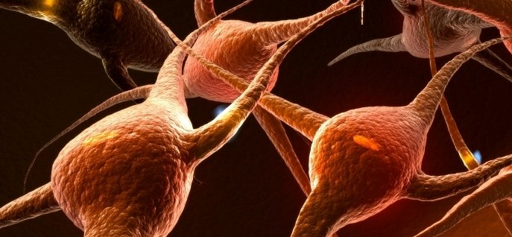
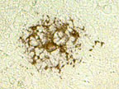
“Neurocentric” Neuroscience misses more than half the picture
microglia
microglia
neurons
astrocytes
oligodendrocytes
Notes:
In fact I was a bit surprised to see as a psychiatrist and neuroscientist, how intensely focused on neurons everyone seemd to be, at the expense of everything else.

Slide 3
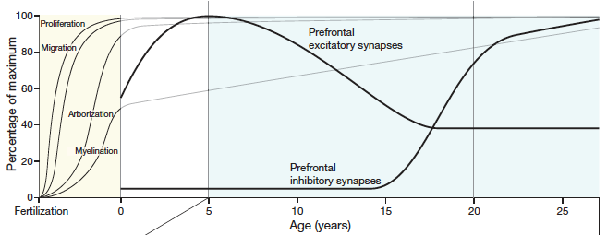
Glial cells are a major feature of the developing brain from mid embryogenesis onwards
GLIAL CELLS
Insel (2010) Nature 468:187
Many psychiatric and other neurodevelopmental diseases likely begin during this period
Glial cells represent potential targets for intervention
Notes:
Here from a review by Tom Insel, the chair of NIMH, you are looking at a rough schematic of human brain development over the first 25 years of life. Neuronal proliferation, migration, arborization and synaptogenesis. Yet through most of these major neuronal milestones, from midgestation onewards, glial cells are a major feature of the landscape. Thus, to my mind, glial cells are important because they may help modulate this critical developmental peirod, but also because they are more proliferative, and likely , more plastic than terminally differentiated neurons.

Slide 4
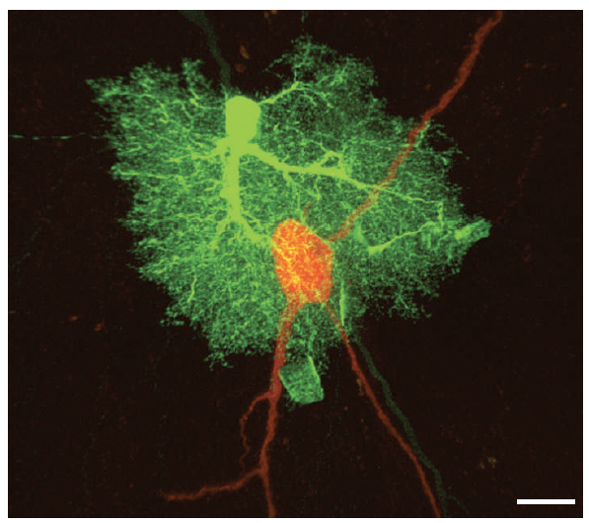
Astrocytes have multiple roles in development, disease, and neurodegeneration
Development:
Support neuronal survival
Maintain blood-brain barrier
Aid synapse formation
Disease:
Autism associated disorders (Rett Syndrome, Fragile X)
“Adult onset” psychiatric diseases (depression, schizophrenia)
Neurodegenerative diseases (Huntington’s, ALS, Parkinson’s)
Allen and Barres (2009) Nature 457:675
Notes:
I’m happy to say that over the past 10 years that viewpoint is gradually changing, as glial cells, particularaly astrocytes, have been shown to have multiple roles in development and disease. Much remains to be done to bring these two sides of the question together.
----- Meeting Notes (4/30/14 18:18) -----
and yet I would argue that we don't know enough about normal astrocyte development to understand what is going wrong in disease. we know 'they must be doing something'

Slide 5
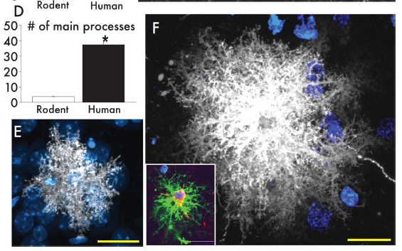
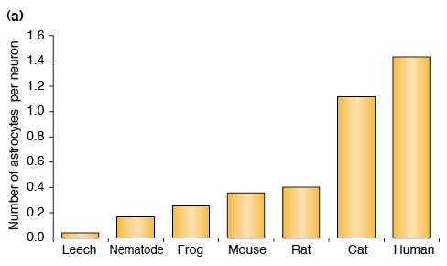
Astrocytes number and size correlate with higher cognitive ability:
Oberheim et al (2009) J Neurosci 29:3276
TINS 2003 26:523.
HYPOTHESIS: glial function is crucial for the increased complexity of neurological function that has occurred during evolution
Notes:
In fact, while many important observations have been made in lower organisms, it is worthwhile to note that the ratio of astrocytes/neurons has increased progressively,

Slide 6
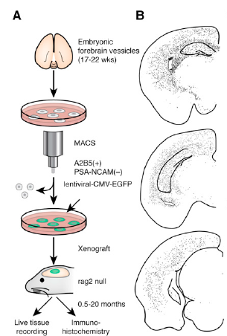
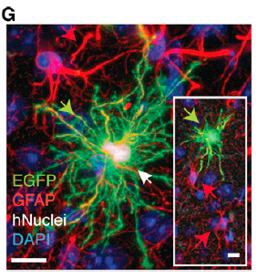
Stem cell derived astrocytes engraft in vivo (and make the mice smart?)

Slide 7
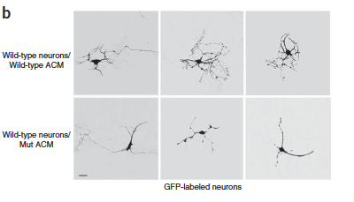
A role for astrocytes in the neurodevelopmental disorder Rett Syndrome

Slide 8
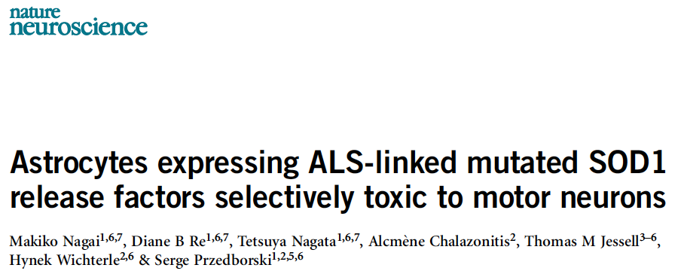
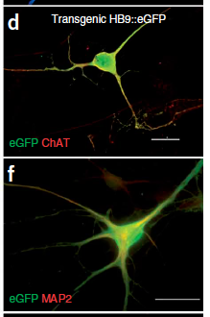
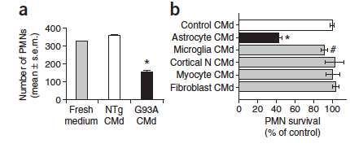
A role for astrocytes in the neurodegenerative disorder ALS

Slide 9
What is an astrocyte?
Morphology
Molecular
Functional
Allen and Barres (2009) Nature 457:675
Notes:
I’m happy to say that over the past 10 years that viewpoint is gradually changing, as glial cells, particularaly astrocytes, have been shown to have multiple roles in development and disease. Much remains to be done to bring these two sides of the question together.
----- Meeting Notes (4/30/14 18:18) -----
and yet I would argue that we don't know enough about normal astrocyte development to understand what is going wrong in disease. we know 'they must be doing something'

Slide 10
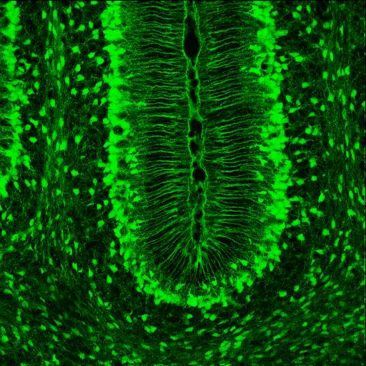
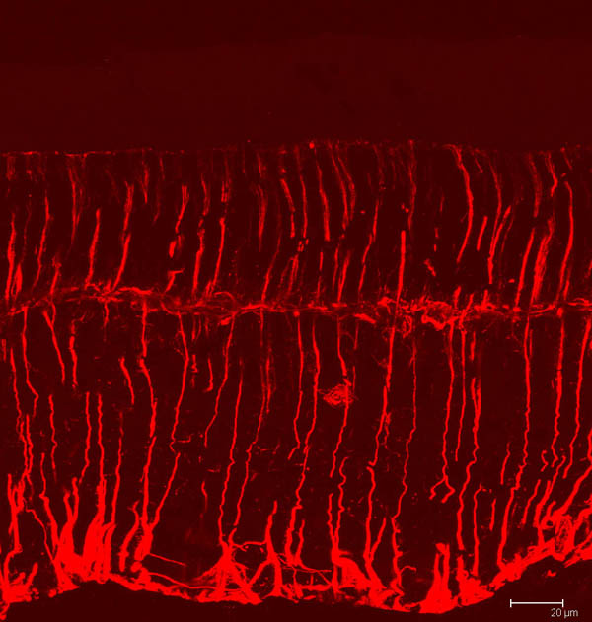
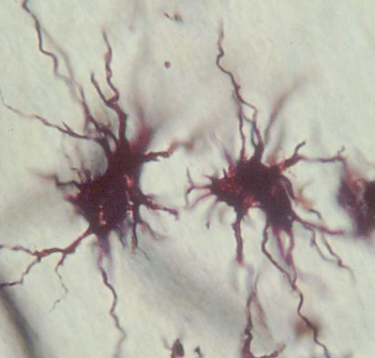
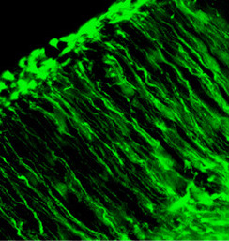
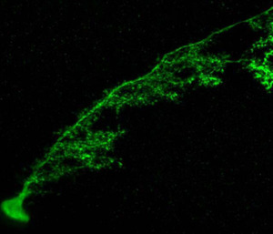
Morphology

Slide 11
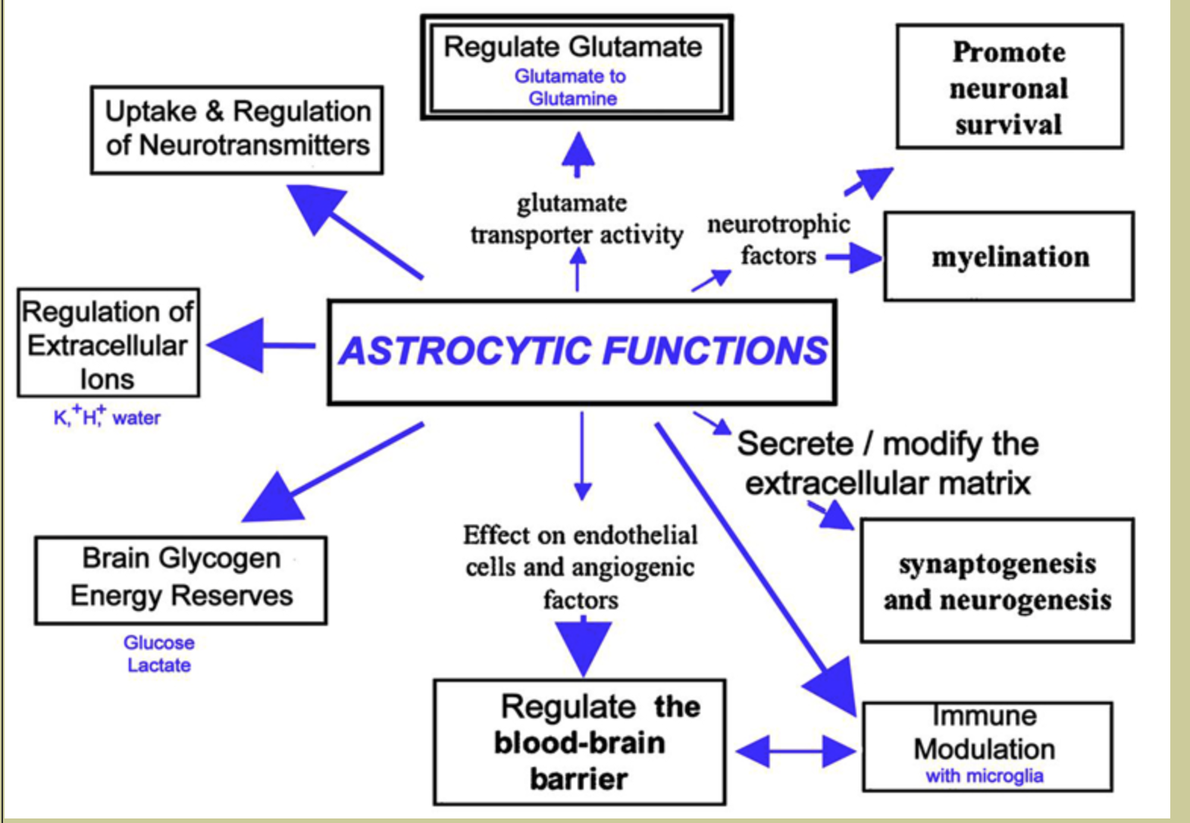
Function

Slide 12
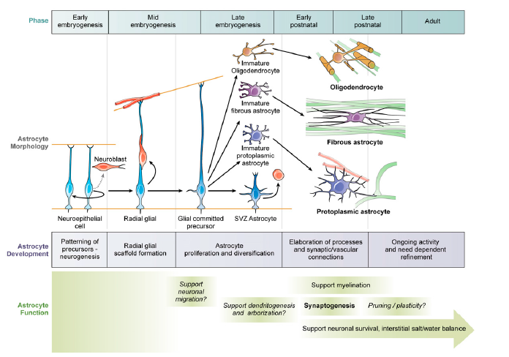
Astrocytes are temporally (functionally) heterogeneous
Molofsky et al 2012

Slide 13
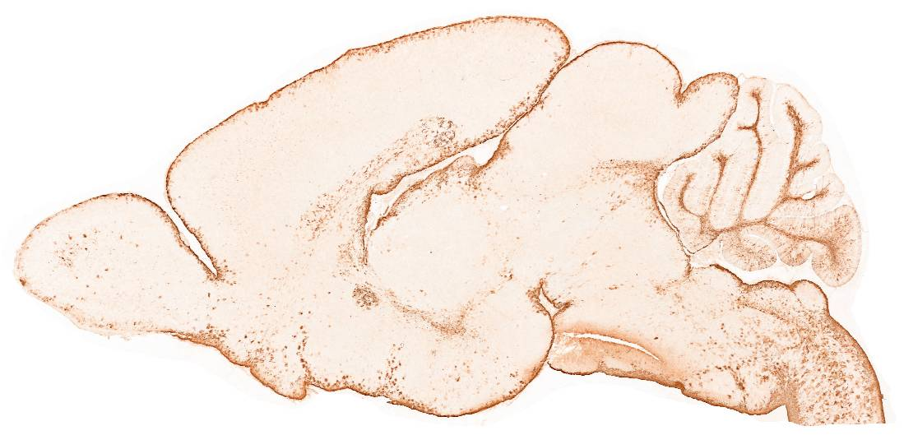
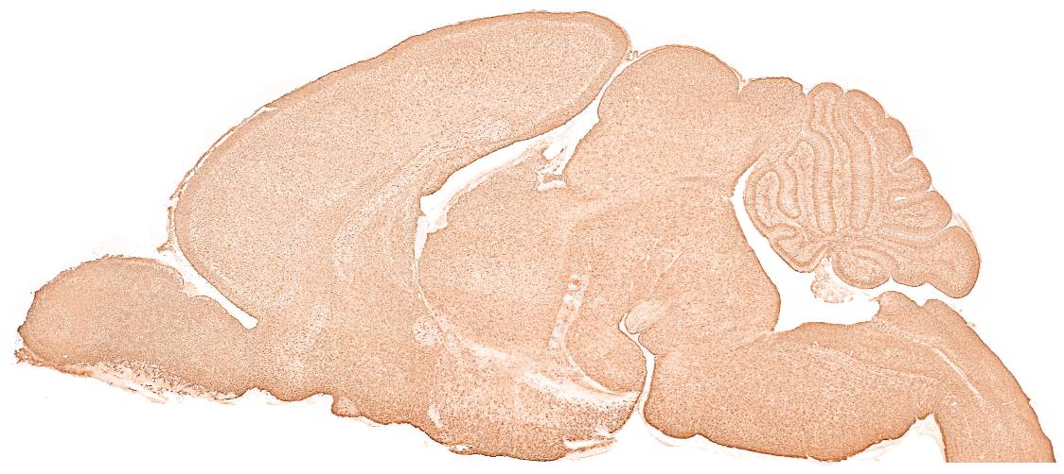
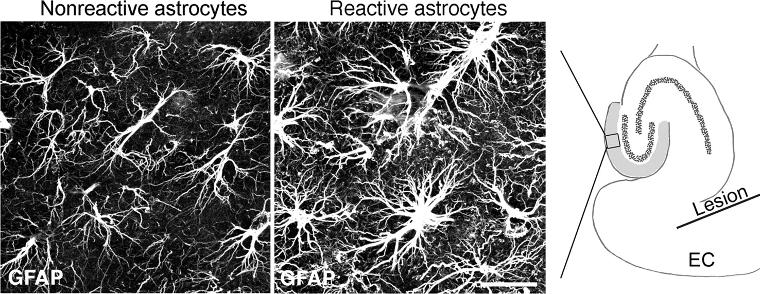
Molecular markers: two examples
GFAP: the “gold standard”
Aldh1L1
EGFP-BAC transgenic, P7, GENSAT project
Cahoy (2008) J Neurosci 28:264
Ulrika Wilhelmsson et al. PNAS (2006)103:17513

Slide 14
Broadest definition
A cell which is not a neuron, not an oligodendrocyte, not a microglia, and not an NG2 cell
In many or most cases may express markers including GFAP, Aquaporin-4, Aldh1l1, Glast, GLT-1, and others
In many or most cases, may have a small nucleus and many fine processes and occupy distinct spatial domains from its glial neighbors
In most cases functional roles include (but not necessarily limited to) metabolic and structural support of the neighboring neurons.

Slide 15
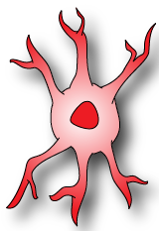
Graphical abstract: the rules of astrocyte generation
Neural
Stem Cell
2. Regional patterning:
Finding: astrocyte precursors are molecularly distinct by CNS region
Open question: does patterning affect astrocyte functional diversity? If so, does it coordinate astrocyte and neuronal diversity?
1. Specification:
Finding: pro-AS TF promote AS at while repressing neurogenesis
Open question: Identification of intermediate astrocyte precursor markers and associated functions
Astrocyte
Precursor
3. Local proliferation:
Implication: small clusters of local astrocytes are clonally related
Open question: proliferation rate cell intrinsic vs environmentally determined?
4. (Local) functional maturation:
Implication: local astrocytes support local circuit function
Open question: cell intrinsic vs environmentally determined?
Functional differences maintained into adulthood?
Mature
Astrocyte
Molofsky and Deneen, Glia (2015) 63:1320.

Slide 16
Astrocyte SPECIFICATION
WHERE are astrocytes specified?
WHEN are astrocytes born?
HOW: what tells a neural stem cell to become an astrocyte?

Slide 17
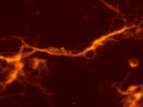
AS specification: astrocytes derive from common progenitor cells that generate neurons and glia
microglia
CNS Stem cell
Self-renewal
Stevens lab
Stem cell
progenitor
Stem cell
neurons
oligos
astrocytes
“macroglia”
Notes:
Just to give a little background on where I am coming from as a neuroscientist, in my phd I studied CNS stem cells and Identified a genetic pathway regulates their decision to self renew (make more stem cells) vs. generating differentiated progeny. This pathway operates throughout the lifespan and its eventual decline is associated with the decreased regenerative capacity of aged stem cells.

Slide 18
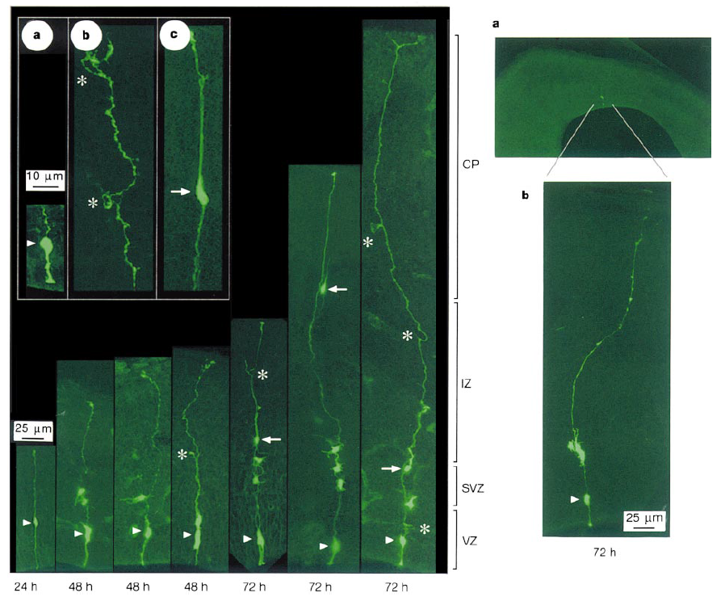
AS specification: WHERE: Ventricular zone radial glial cells are neural stem cells in vivo

Slide 19
Radial glia throughout the brain
doi:10.1038/ncomms1460

Slide 20
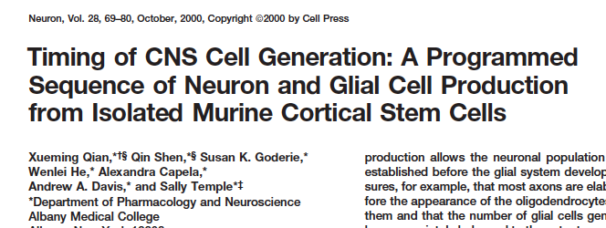
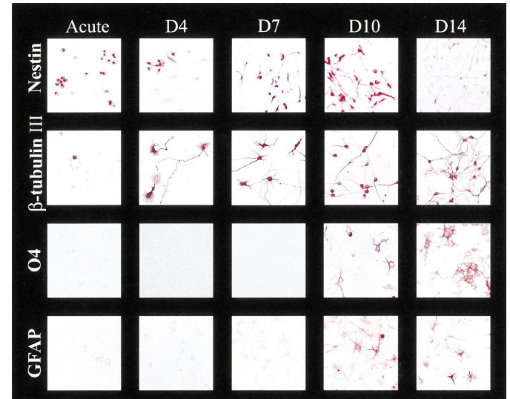
AS specification: WHEN: First neurons, and then glia
Possibilities:
1-- Astrocytes by “default”
2-- A“switch” from neurons to glia could be sufficent to specify astrocytes?

Slide 21
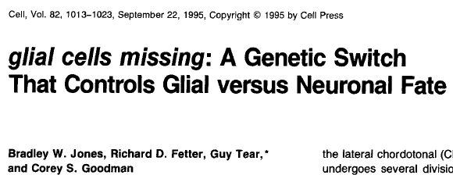
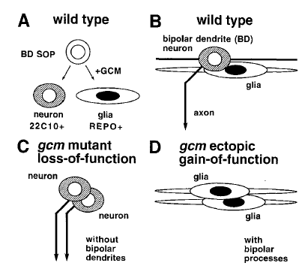
HOW: Specifying astrocytes via a neuron-glia “switch”*: the story of glial cells missing (gcm)
Specification
* note: does not apply to mammals

Slide 22
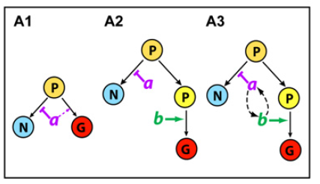
Glial specification in vertebrates is multifactorial : NFIA is a pro-glial transcription factor

Slide 23
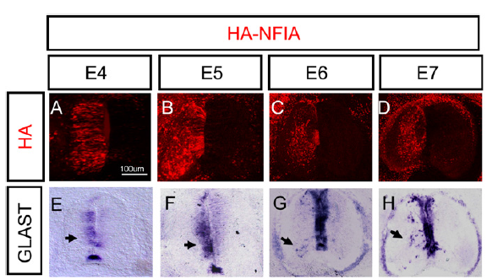
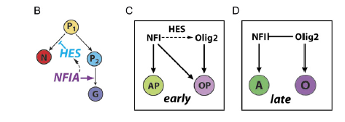
Glial specification in vertebrates is multifactorial : NFIA is a pro-glial transcription factor (upstream of sox9)
Implications: mechanisms of glial specification may not be conserved across species

Slide 24
Graphical abstract: the rules of astrocyte generation
Neural
Stem Cell
2. Regional patterning:
Finding: astrocyte precursors are molecularly distinct by CNS region
Open question: does patterning affect astrocyte functional diversity? If so, does it coordinate astrocyte and neuronal diversity?
1. Specification:
Finding: pro-AS TF promote AS at while repressing neurogenesis
Open question: Identification of intermediate astrocyte precursor markers and associated functions
Astrocyte
Precursor
3. Local proliferation:
Implication: small clusters of local astrocytes are clonally related
Open question: proliferation rate cell intrinsic vs environmentally determined?
4. (Local) functional maturation:
Implication: local astrocytes support local circuit function
Open question: cell intrinsic vs environmentally determined?
Functional differences maintained into adulthood?
Mature
Astrocyte
Molofsky and Deneen, Glia (2015) 63:1320.

Slide 25
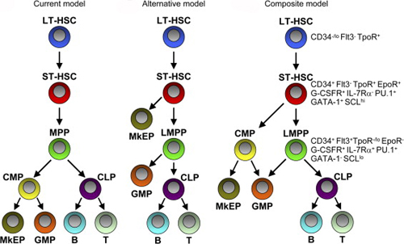
Many little balls: the hematopoietic model of lineage specification

Slide 26
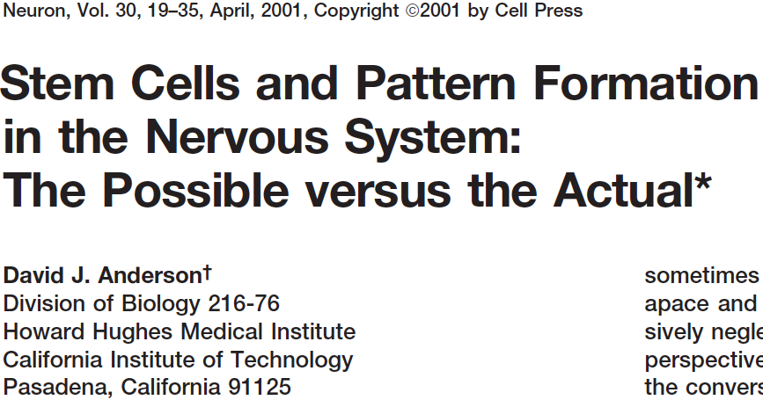
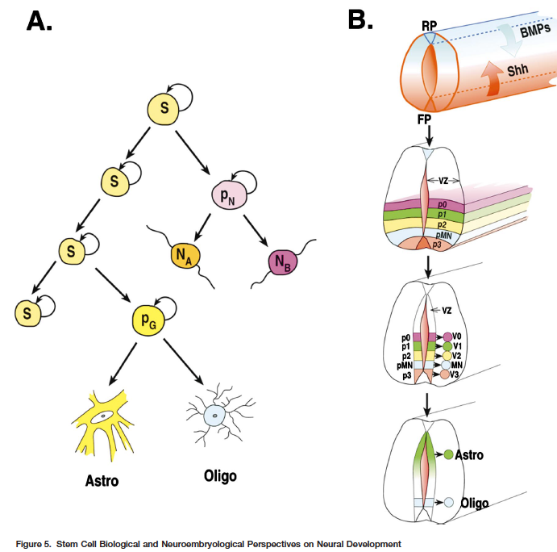
From the great David Anderson: patterning matters

Slide 27
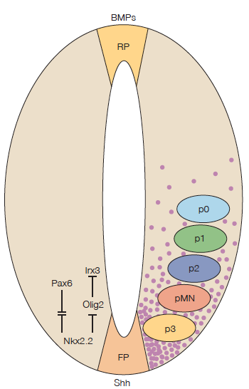
Patterning confers distinct regional identity to CNS progenitors
Rowitch 2004

Slide 28
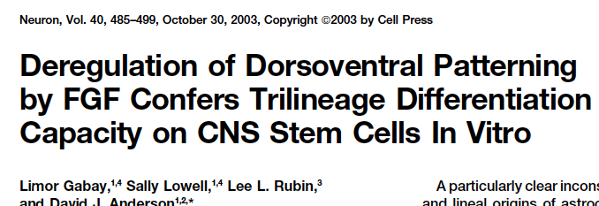
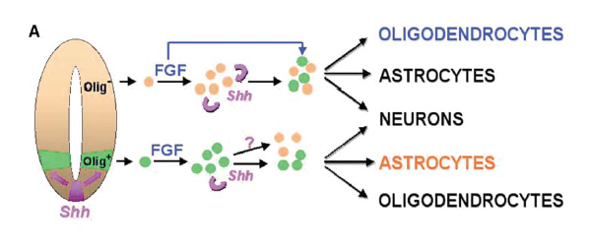
A cautionary tale: FGF in vitro “de patterns” neural stem cells

Slide 29
De-patterning in vitro can confuse our understanding of developmental programs
Courtesy of D Rowitch

Slide 30
Astrocytes are patterened and as a result are positionally heterogeneous
New York
East Coast
Bay Area
San Francisco
Molofsky et al, Genes Dev 2012 (26:891)
Astrocyte patterning:
Hochstim (2008) Cell 133:510.
Tsai (2012) Science 337:338.
Notes:
As I was starting my postdoc, a new idea about astrocyte development was beginning to emerge, David Anderson’s group, and Lily Jan’s group suggested that there were some conserved principles in astrocyte development that raise important new questions
It has been known for some time now how dorsoventral patterning gradients in the developing neural tube determine functional subtypes of interneurons, and that oligodendrocytes are born from specific dorsoventral domains, such as the pMN domain early in development.
But what about astrocytes? astrocytes born from ventricular radial glial progenitors migrate radially and proliferate locally.
Then they stay right there, into adulthood, after injury, basically no matter what you do to them.
The end result is embryonically realted wedges that you see here. It raises the important possiilty that astrocyte location is an important determinant of astrocyte heterogeneity.

Slide 31
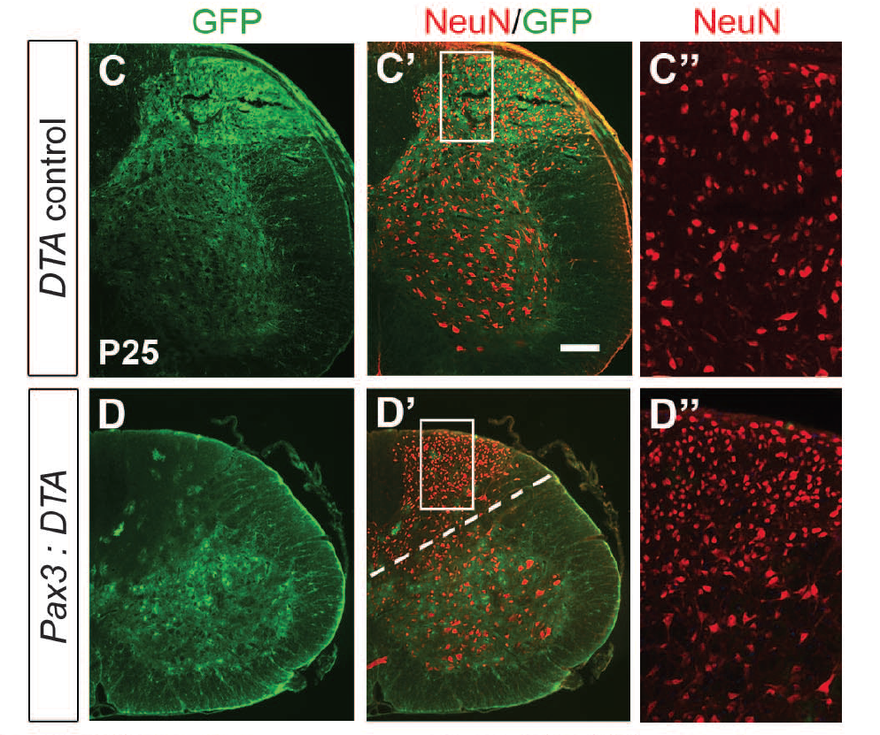
Astrocyte position is fixed even after depletion of astrocytes from adjacent domains
Molofsky/Li
Tsai (2012) Science 337:338.

Slide 32
Forebrain astrocytes are also patterned
John Rubenstein and others

Slide 33
Radial glial to astrocyte transition illustrates a continuous glial “scaffold”
Lucho Fuentealba, Florian Merkle, from Tsai et al 2012(Science 337:338)
Notes:
Lest you think that astrocytes exist in discrete “wedges” all over the brain, I want to show you a different pictore of what this looks like from the perspective of a stem cell biologist.
A positional reminder of where the radial glia used to be
Their positional stability through developmental time.

Slide 34
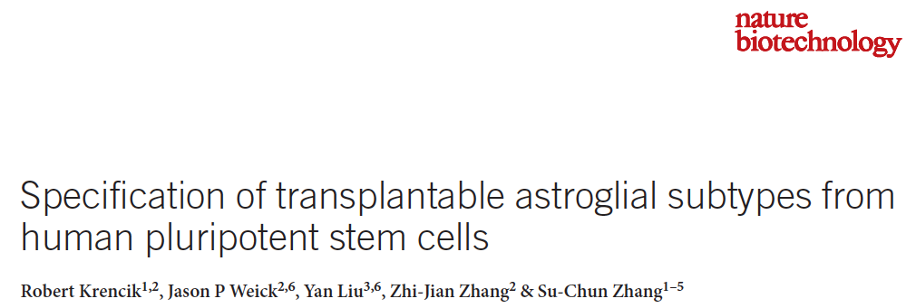
Patterning can be harnessed for in vitro studies of astrocyte heterogeneity

Slide 35
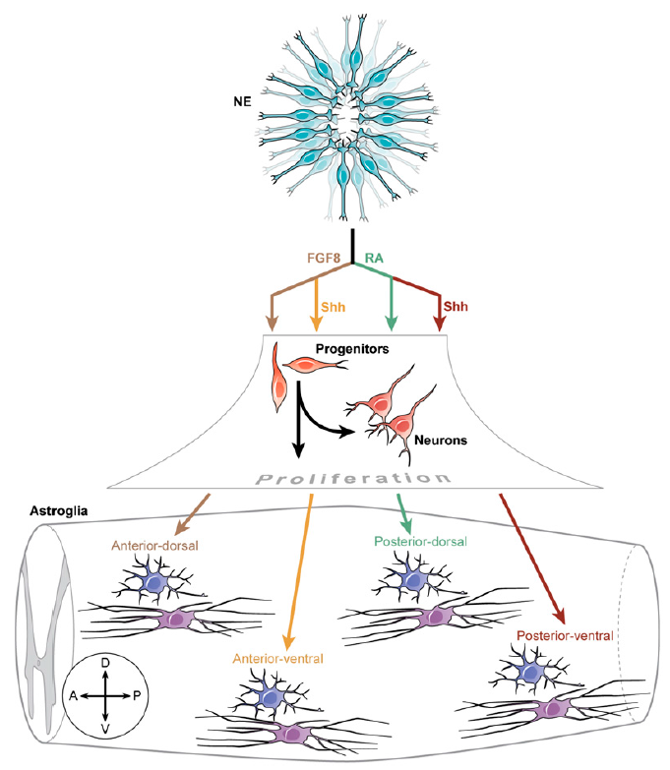
Astrocyte patterning in vitro: are functionally distinct subtypes generated? Are these relevant to disease (cell based therapies, for example)?
Molofsky et al 2012

Slide 36
Positional identity is the fundamental organizing principle of the brain and is encoded early in neural development

Slide 37
Summary of astrocyte specification from stem cells: there is no stem cell*
* In the brain, regional identity rules

Slide 38
Graphical abstract: the rules of astrocyte generation
Neural
Stem Cell
2. Regional patterning:
Finding: astrocyte precursors are molecularly distinct by CNS region
Open question: does patterning affect astrocyte functional diversity? If so, does it coordinate astrocyte and neuronal diversity?
1. Specification:
Finding: pro-AS TF promote AS at while repressing neurogenesis
Open question: Identification of intermediate astrocyte precursor markers and associated functions
Astrocyte
Precursor
3. Local proliferation:
Implication: small clusters of local astrocytes are clonally related
Open question: proliferation rate cell intrinsic vs environmentally determined?
4. (Local) functional maturation:
Implication: local astrocytes support local circuit function
Open question: cell intrinsic vs environmentally determined?
Functional differences maintained into adulthood?
Mature
Astrocyte
Molofsky and Deneen, Glia (2015) 63:1320.

Slide 39
Astrocyte PROLIFERATION
WHERE do astrocytes proliferate?
WHEN do they proliferate?
WHAT molecular mechanisms regulate this?

Slide 40
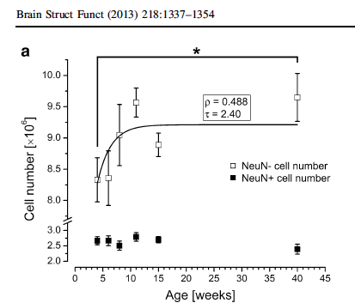
Astrocyte proliferation: WHEN?
Spinal cord: ~E14.5-P2 (mouse)
Cortex: ~E16-P14 or 21 (mouse)
Human?? We don’t quite know

Slide 41
AS Proliferation: WHERE Bimodal in the spinal cord: first at the ventricular zone, and again in the parenchyma
Green= Aldh1L1-GFP astrocytes

Slide 42
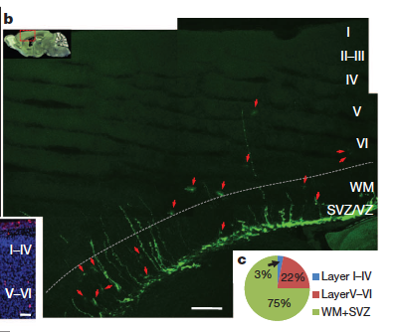
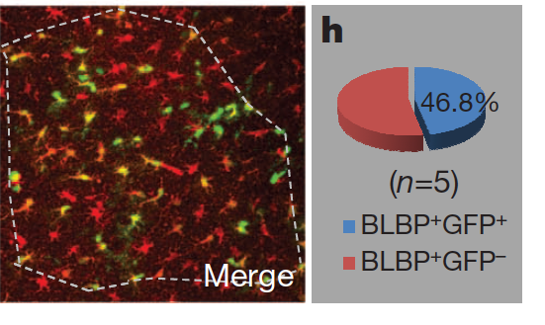
AS Proliferation: WHERE Bimodal in the cortex: about half at the ventricular zone, and half in the parenchyma
Retroviral labeling of SVZ astrocytes
Retroviral labeling of local cortical astrocytes

Slide 43
Location, location location: Astrocytes are positionally heterogeneous
Molofsky et al, Genes Dev 2012 (26:891)
Astrocyte proliferation:
Tien (2012) Development 139:2477.
Ge (2012) Nature 484:376.
Astrocyte patterning:
Hochstim (2008) Cell 133:510.
Tsai (2012) Science 337:338.
Notes:
As I was starting my postdoc, a new idea about astrocyte development was beginning to emerge, David Anderson’s group, and Lily Jan’s group suggested that there were some conserved principles in astrocyte development that raise important new questions
It has been known for some time now how dorsoventral patterning gradients in the developing neural tube determine functional subtypes of interneurons, and that oligodendrocytes are born from specific dorsoventral domains, such as the pMN domain early in development.
But what about astrocytes? astrocytes born from ventricular radial glial progenitors migrate radially and proliferate locally.
Then they stay right there, into adulthood, after injury, basically no matter what you do to them.
The end result is embryonically realted wedges that you see here. It raises the important possiilty that astrocyte location is an important determinant of astrocyte heterogeneity.

Slide 44
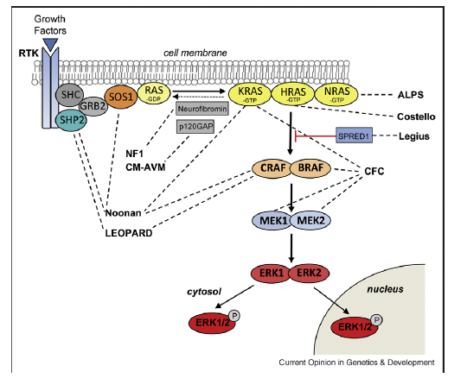
Astrocyte proliferation: HOW? Ras/MapK pathway
Tien (2012) Development 139:2477
Li (2012) Neuron 75:1035.

Slide 45
Interesting directions in astrocyte proliferation . . .
If they proliferate locally, is the proliferation rate responsive to local signals?
(what growth factors upstream of the Ras/MAPK pathway are regulating astrocyte proliferation?)

Slide 46
Graphical abstract: the rules of astrocyte generation
Neural
Stem Cell
2. Regional patterning:
Finding: astrocyte precursors are molecularly distinct by CNS region
Open question: does patterning affect astrocyte functional diversity? If so, does it coordinate astrocyte and neuronal diversity?
1. Specification:
Finding: pro-AS TF promote AS at while repressing neurogenesis
Open question: Identification of intermediate astrocyte precursor markers and associated functions
Astrocyte
Precursor
3. Local proliferation:
Implication: small clusters of local astrocytes are clonally related
Open question: proliferation rate cell intrinsic vs environmentally determined?
4. (Local) functional maturation:
Implication: local astrocytes support local circuit function
Open question: cell intrinsic vs environmentally determined?
Functional differences maintained into adulthood?
Mature
Astrocyte
Molofsky and Deneen, Glia (2015) 63:1320.

Slide 47
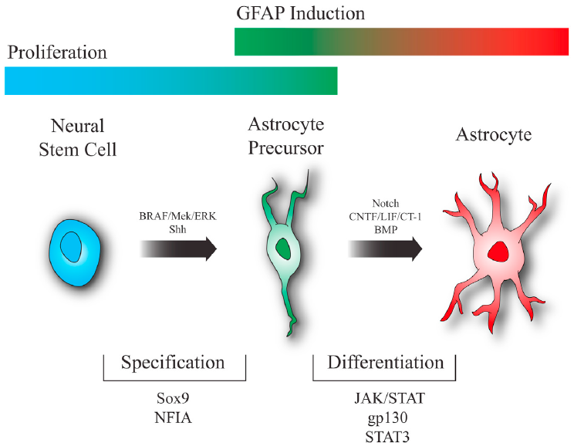

Slide 48
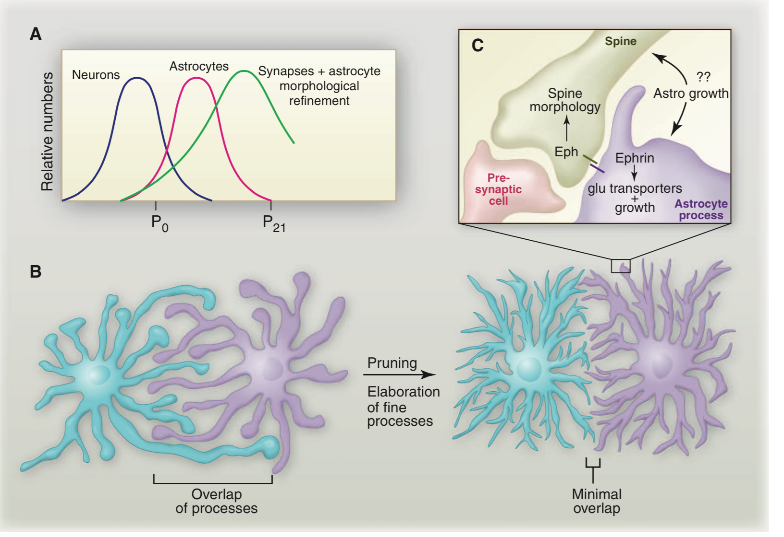
Astrocyte morphological maturation: fillopodial growth followed by spatially segregated domains

Slide 49
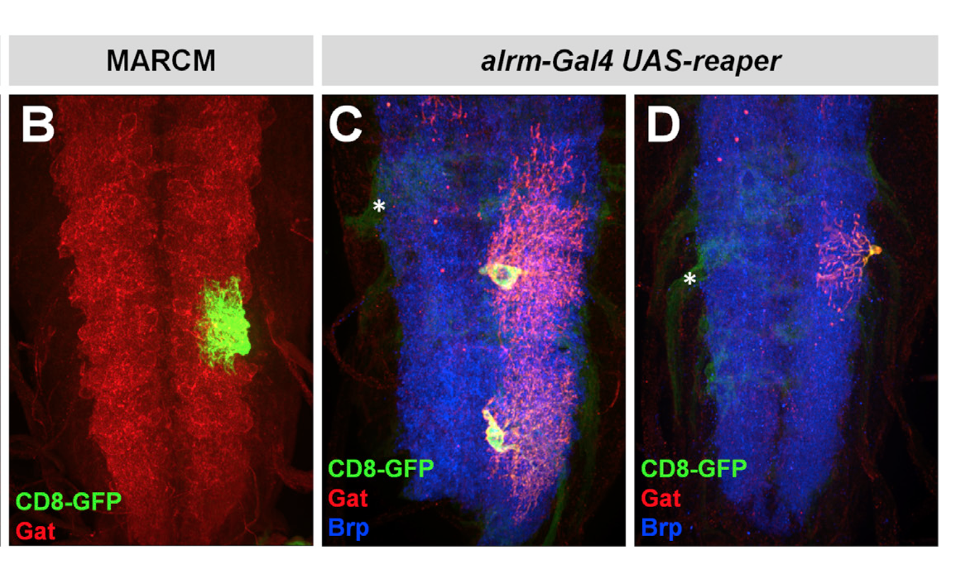
Cell cell contacts regulates astrocyte tiling in drosophila

Slide 50
Interesting… but understanding astrocyte functional maturation requires one key step: understanding astrocyte function… and for that, we need to know, is there one generic role for astrocytes, or many?

Slide 51
AS are heterogeneous by tissue type: Two morphological types of astrocytes: fibrous (white matter) and protoplasmic (gray matter)
GFAP: dim or neg GFAP: bright

Slide 52
Evidence for astrocyte functional heterogeneity is not new

Slide 53
Investigating the molecular basis of astrocyte regional heterogeneity
Notes:
Here is the circuit that I’ll be talking about. . . .
As a psychiatrist, I’m very intersted in behavioral circuits, but to understand the molecularl interactions btw astros and neurons, I started with this simple and elegant one.

Slide 54
Sema3a: what is it doing in postnatal spinal cord astrocytes?
Molofsky (2014) Nature 509:189.
HYPOTHESIS: astrocyte Sema3a is required for motor neuron support

Slide 55
Sema3a: a developmentally secreted factor required for motor neuron positioning, survival and function
Mispositioning
Synaptic Defects
(decreased exitatory synapses/ePSCs
Increased inhibitory synapses/iPSCs)
MN hyperexcitability
N
Death
direct effects of AS Sema3a on MN
Notes:
Don’t need the disease thing at the bottom. Spacer slide – this is an astrocyte penotype. – A SPACER (work on this transition).

Slide 56
The CNS massively expands while forming highly specific neural circuits
Source: NIH MRI Study of Normal Brain Development
How is positional information maintained during postnatal growth?
Notes:
I want to start with what I see as a fundamental problem in neurobiology: The developing brain forms highly specific neural connctions, but also undergoes massive expansion while doing so. We know a lot about how positional molecules, axon guidance cues and the like, influence the very earliest stages of brain development, but how do those principles scale up in a growing brain. Is there a mechanism for mantaining this positional information?

Slide 57
Are developing forebrain astrocytes molecularly heterogeneous?
SVZ

Slide 58
Expression profiling of developing forebrain astrocytes by RNA sequencing

Slide 59
Astrocyte maturation: evidence for NURTURE?

Slide 60
Astrocyte maturation: evidence for NURTURE?

Slide 61
Astrocyte maturation: evidence for NURTURE?

Slide 62
Case in point: A lack of good astrocyte markers
GFAP: the “gold standard”
Aldh1L1
EGFP-BAC transgenic, P7, GENSAT project
Cahoy (2008) J Neurosci 28:264
Ulrika Wilhelmsson et al. PNAS (2006)103:17513

Slide 63
Astrocyte maturation: evidence for NATURE?
If astrocytes are patterned, it is possible that regional astrocyte functions are also prespecified at the time of embryonic patterning.

Slide 64
Coda: reactive astrocytes and the injury response Astrocytes are designed to respond to stress
Wilhelmsson et al. PNAS (2006)103:17513

Slide 65
Reactive astrocytes are molecularly heterogeneous

Slide 66
Reactive astrocytes proliferate heterogeneously

Slide 67
Advertisement
Want to know more?
Consider the mini-course on Glia this spring. . . With many exciting guest lecturers

